Slide 1
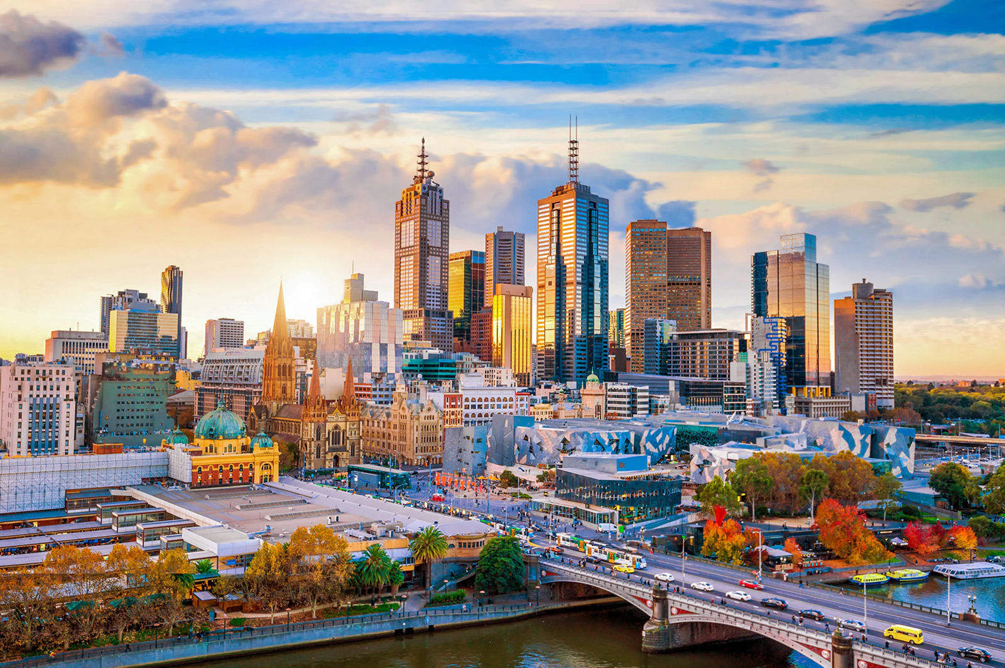
Final Presentation: IBM Applied Data Science Capstone Project : Finding and Analysing the best suburbs to live in Victoria, Australia .
Michael Le

Slide 2
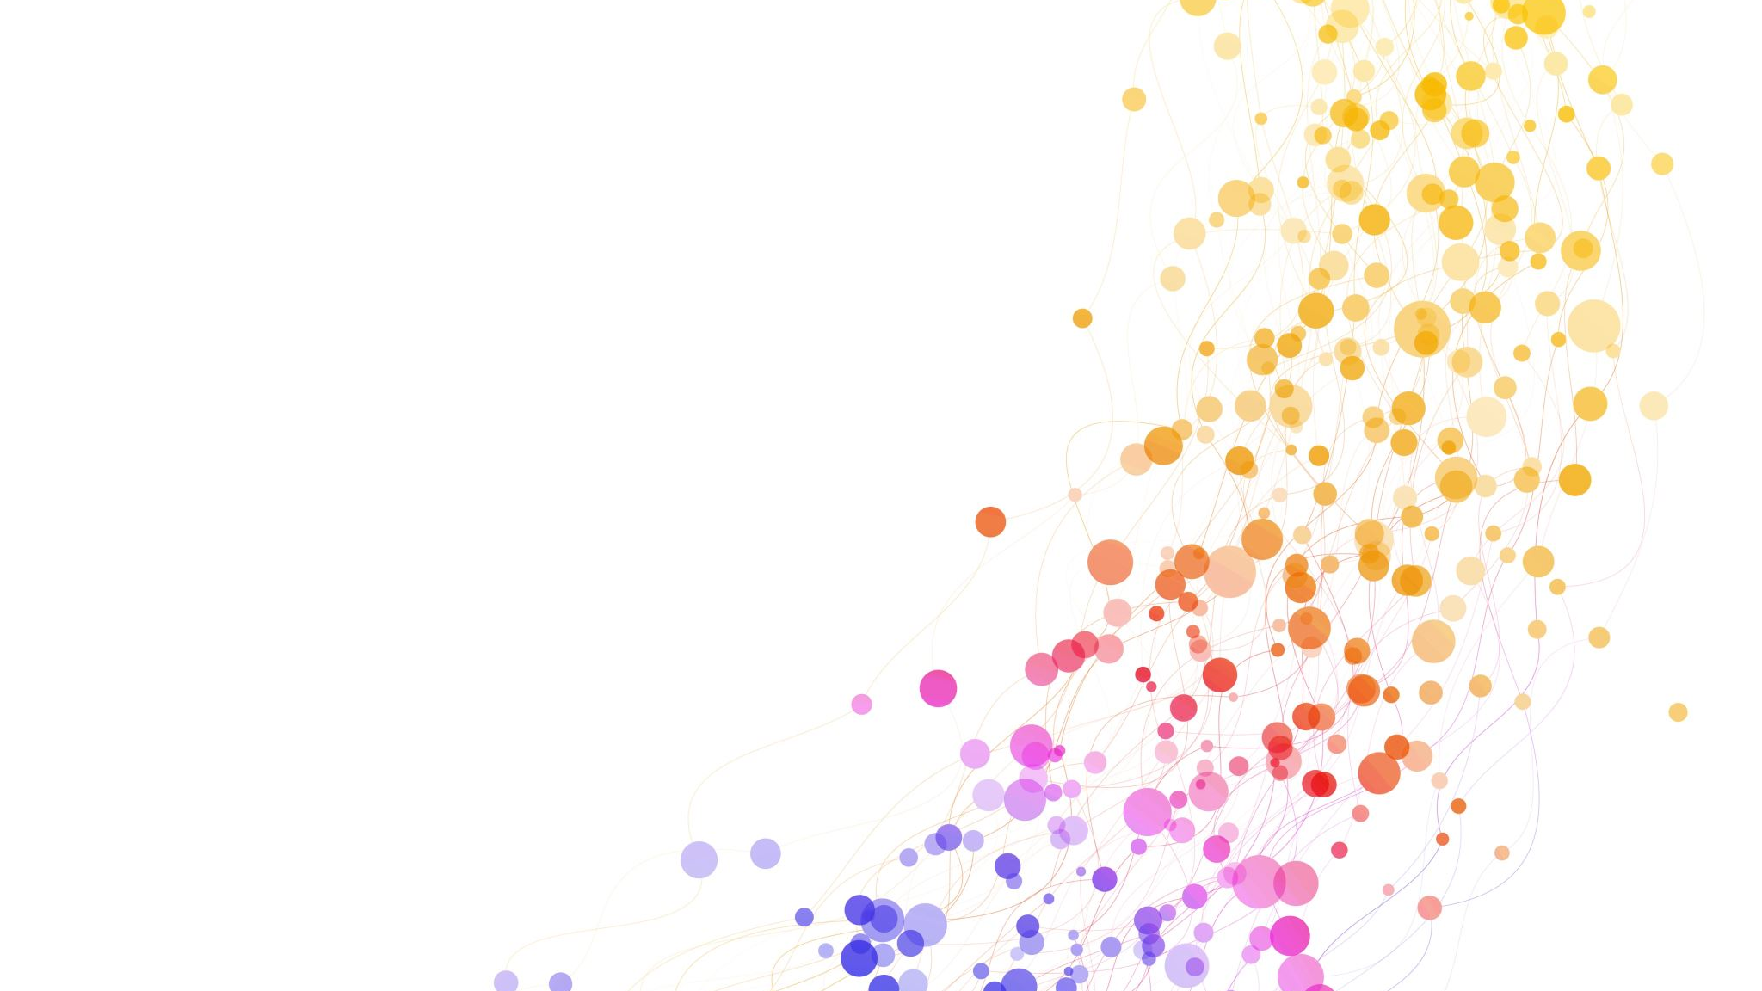
OUTLINE
Executive Summary
Introduction
Methodology
Data Cleaning
Results/Discussion
Conclusion
Appendix

Slide 3
Executive Summary
Why Melbourne, Victoria Australia?
Australia is one of the multicultural country and sporting capitals in the world. According to the Economist Intelligence Unit’s Global Livability for 2022 Melbourne was ranked for number 1 most livable city. Due to the low crime rates, career opportunities, transportation, university costs and better cultural lifestyle.

Slide 4
Introduction
Our goal is to find and help residents to locate the better suburb to live in. We must consider some factors involved when applying for the search of finding the new home based on customer feedback, service, satisfaction and reviews. For instance such as liveability, parkland, shopping, schools, transport, walkability and healthcare services. To help citizens creating better decisions to enjoy a better experience and safety for future residents.

Slide 5
Methodology
To tackle on this approach, we need to apply the ten steps to organise the overall Data Science narrative without losing time. Data Science Methodology requires us to collect labelled data, analysis, visualization, statistics and machine learning techniques for better understanding trends or patterns within the data to prepare for Modelling Evaluation to ensure it is deployed to our stakeholders and ventures in business in real-state and conveying.

Slide 6
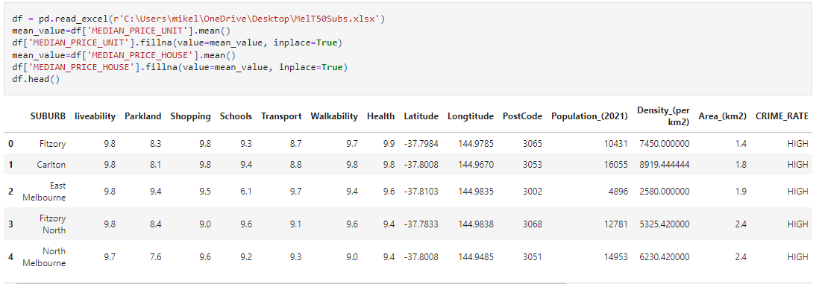
Data Cleaning
Here my data-frame consists of 19 columns and 50 rows

Slide 7
Results/Discussion

Slide 8
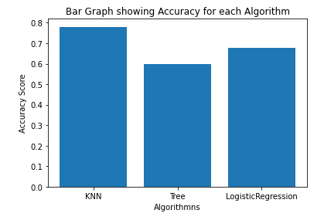
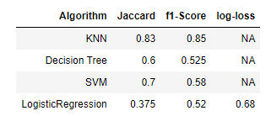
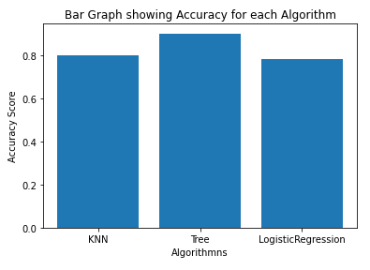
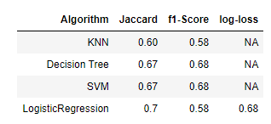
Supervised Learning: Classification
Without the Hyperparameter
Here, we use Community as our y-variable vs. Features according to the realstate.com we normalise the data to perform classification models including the Poverty Rates testing 20% of the test data. Without the Hyperparameter KNN is the best model. But with the hyperparameter Tree performs the best model, safer to use the Logistic Regression as our to model to avoid overfitting.
With the Hyperparameter

Slide 9
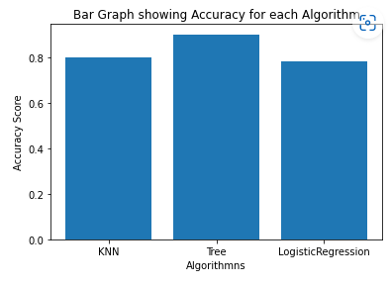
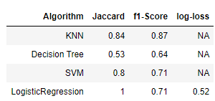
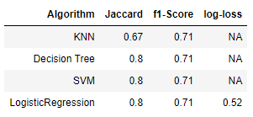
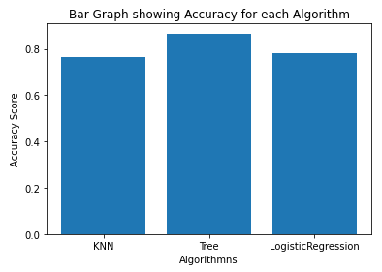
Without the Hyperparameter
Replacing Poverty Rates with Crime Rates within our features. Instead of using 20% we use 40% of the test data to get these following results. Without the added hyperparameter we get the Tree as our best model. Similar for the hyperparameter case.
With the Hyperparameter

Slide 10
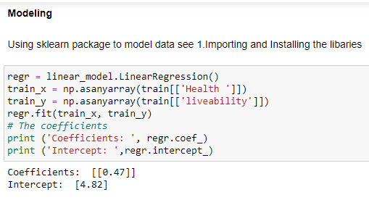
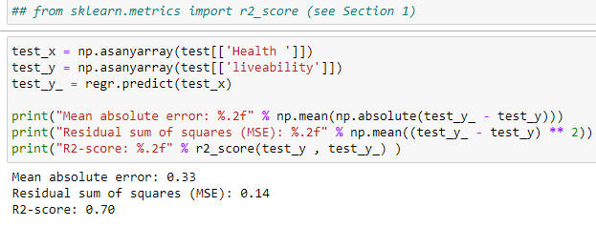
Supervised Learning: Linear Regression
After careful comparison with other features in the model, Liveability vs. Health performs the best model depends the higher R squared value. The better the model fits the regression line. This may be because there large number of good quality hospitals and health care system. In this case why life mortality and expectancy in Victoria, Australia has increased.

Slide 11
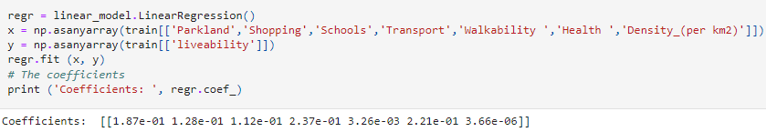
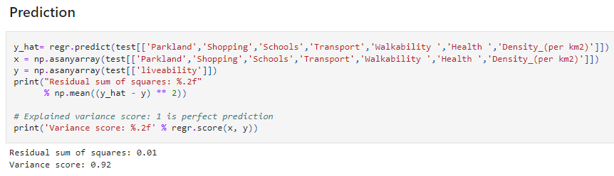
Supervised Learning: Multiple Linear Regression
We find out the variance score is 0.92 meaning that our model is perfectly valid in this case in the following features we have selected to ensure the model fits well. Similar reason applied for the linear regression case.

Slide 12
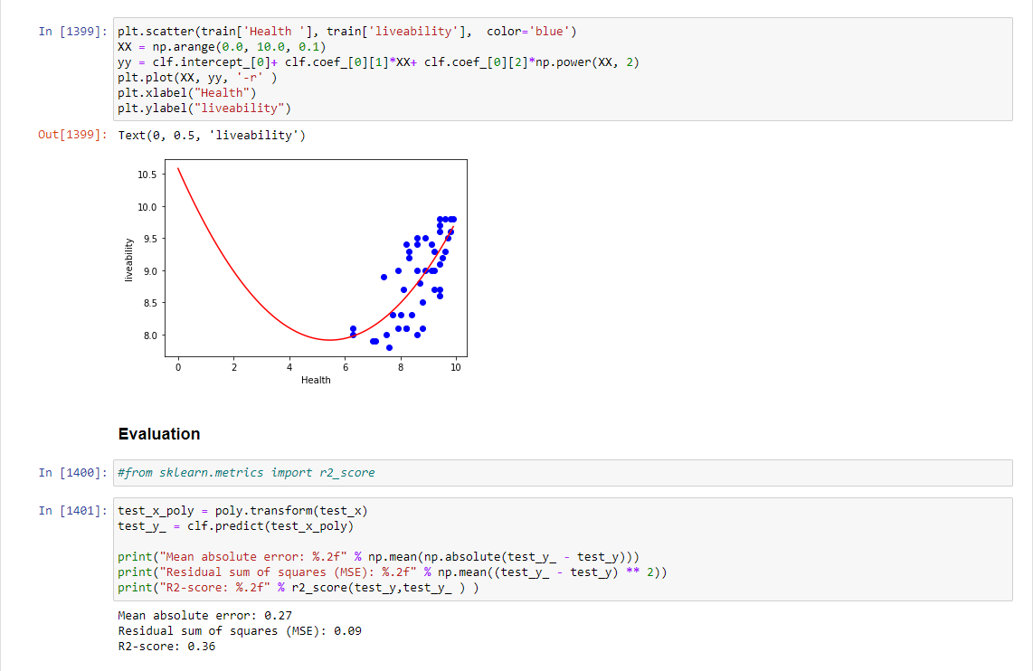
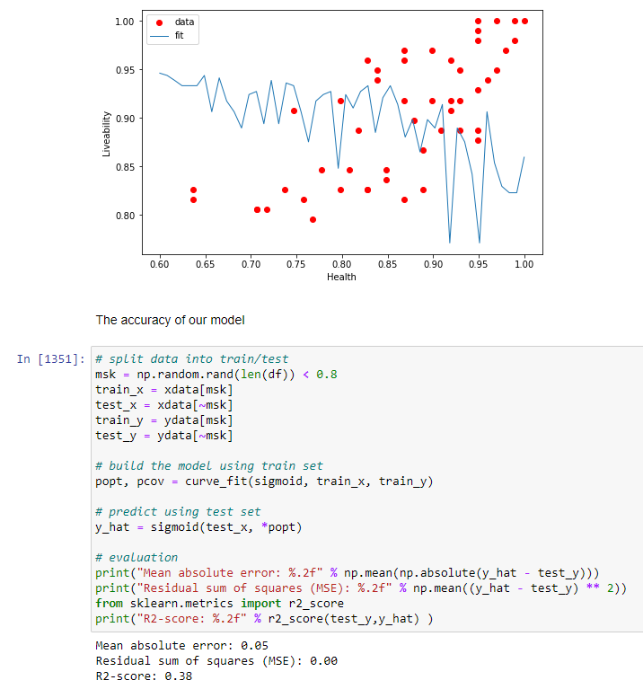
Supervised Learning: Non-Linear Regression Analysis and Polynomial Regression
After careful consideration fitting Health vs. Liveability comparing to other features in the data-frame, works better. Similar reason from the Linear Regression with the exception that the Non-Linear case here the model does not fit very well whereas the polynomial regression fits slightly worst than the non-linear case.

Slide 13
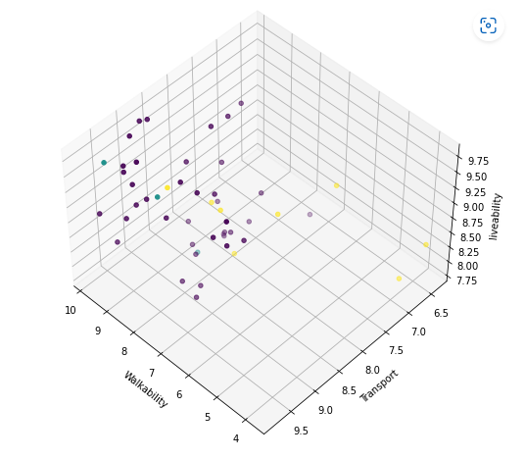
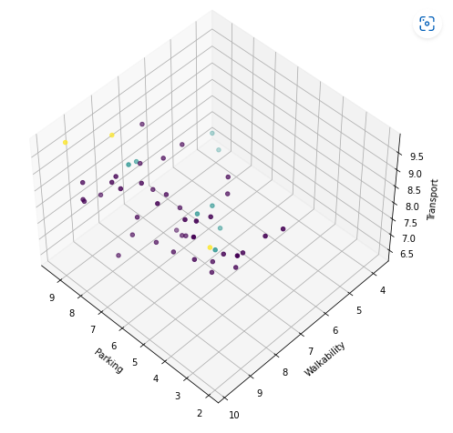
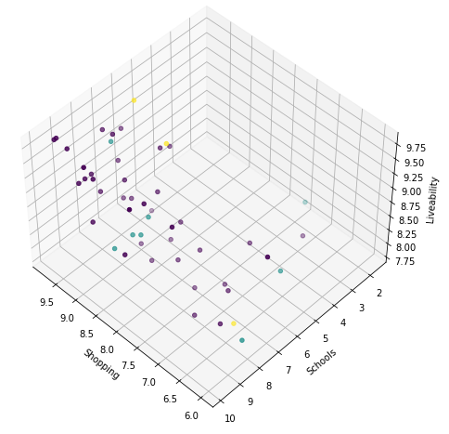
Un-Supervised Learning: K-Means Clustering
There are 3 clusters. In Figure 1, It shows that the most of the clusters. Are crowded around the left corner whilst we notice small data points on the right corner due to low number of transportation and accessibly to their environment. In Figure 2 shows most of the data points are closer to the centre, whereas parking is an main issue due to the shortage of parking spaces, high volumes of traffic congestion due to the number of people living in that particular suburb. In order to reduce the stress and time in terms of transportation and physical endurance. Figure 3, In terms of liveability shows a large number of quality shops in Victoria, notice there is a small number of data points with lower schools scores and liveability that are heavily impacted due to poverty, classroom size and outdated technology due to budget constraints.
Figure 1
Figure 2
Figure 3

Slide 14
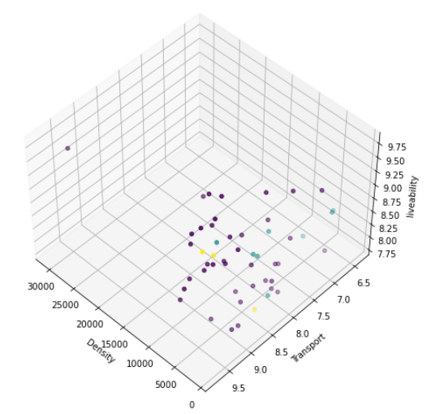
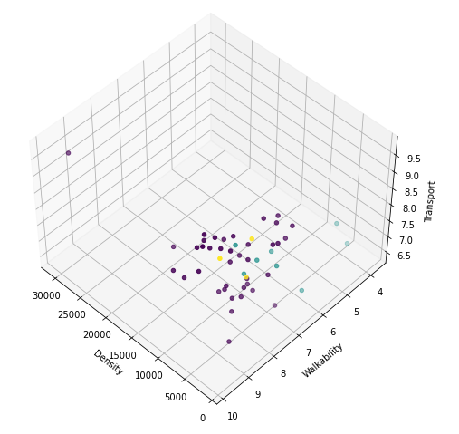
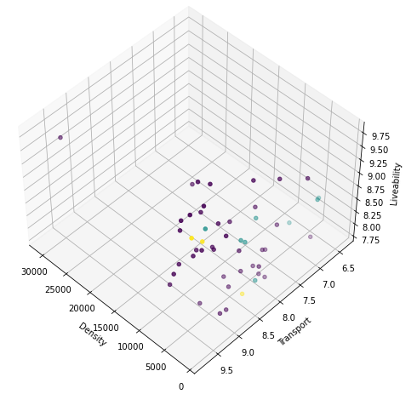
In Figure 4, There is one data point close to the left corner possibly Urban suburb despite Transportation and Life expectancy. Oddly enough the rest of them covered most of the right half of the figure despite less density, accessibly of transport seems decent in terms of liveability may vary be effect due to impacted on delays, interruption, incidents and stoppage causes by natural disasters. In Figure 5, similarly to Figure 4 except there is two data points close to the right corner due to low accessibly and density similar to Figure 3. In Figure 6 share similar reasons to Figures 4 and 5.
Figure 4
Figure 5
Figure 6

Slide 15
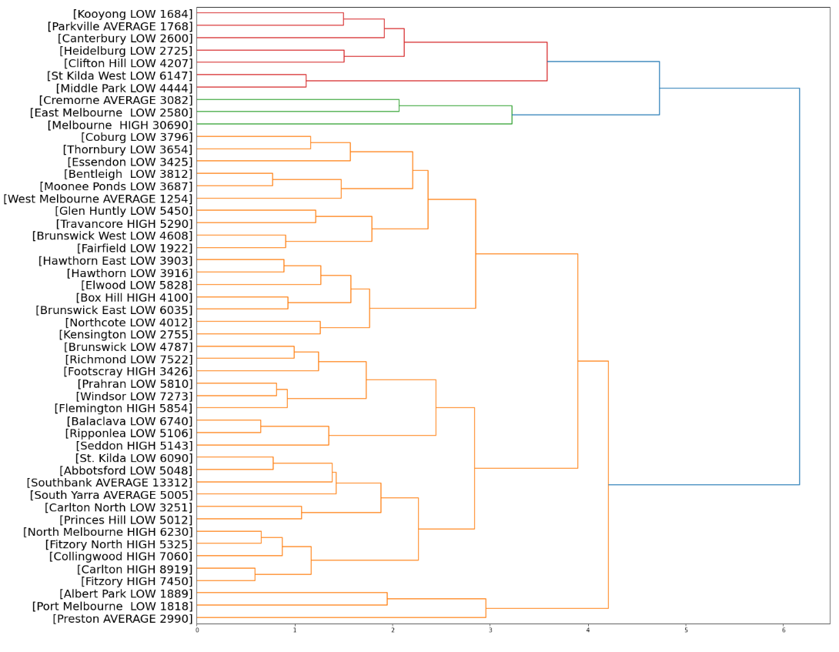
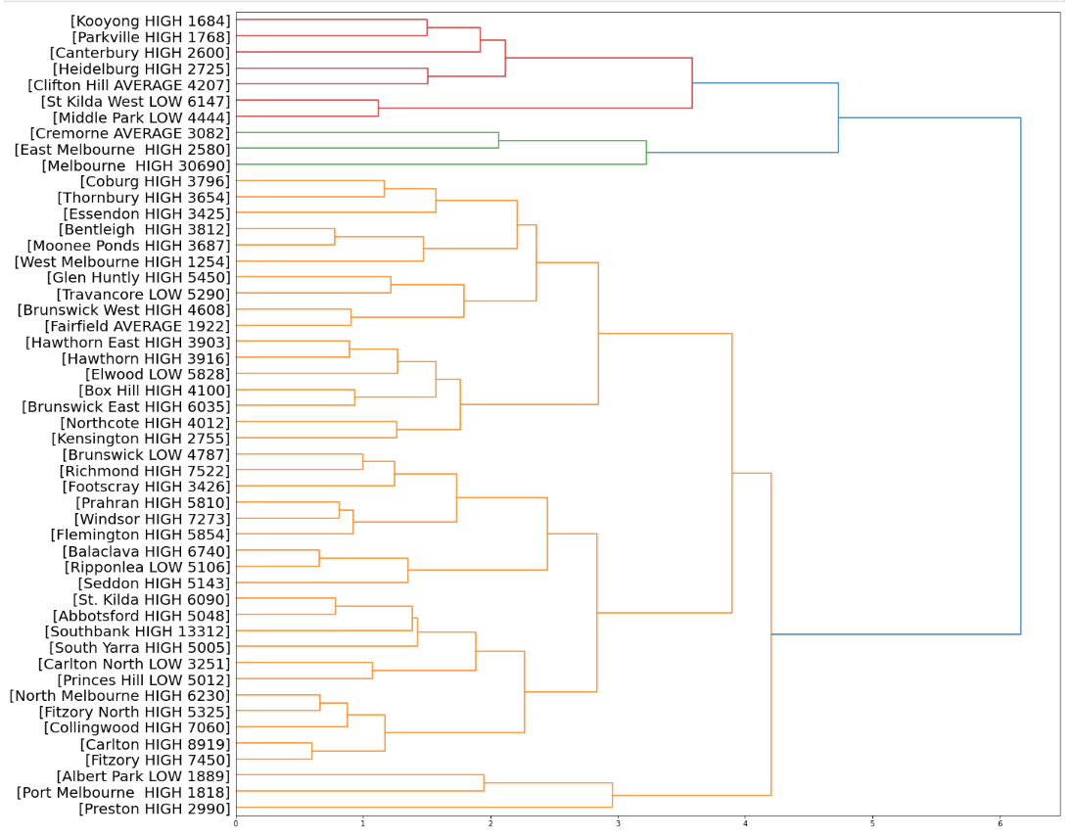
Un-Supervised Learning: Hierarchical Clustering Density-Based Clustering
PROVERTY-RATE
CRIME-RATE

Slide 16
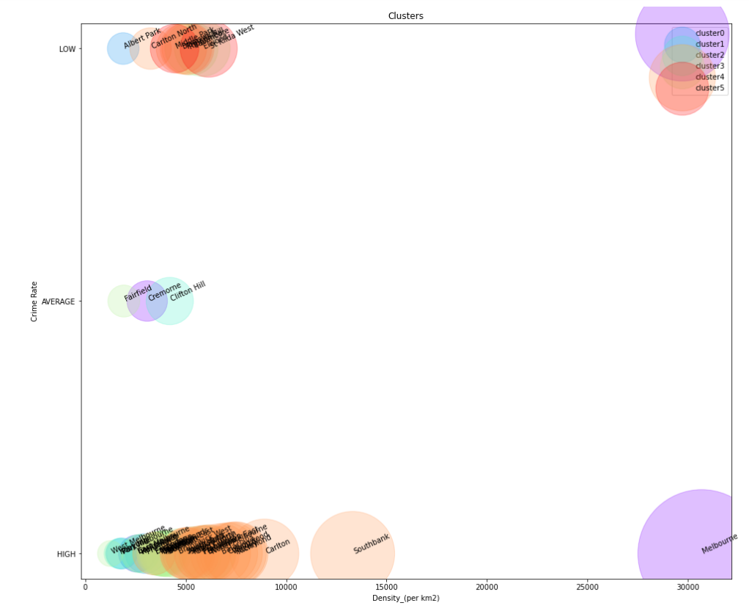
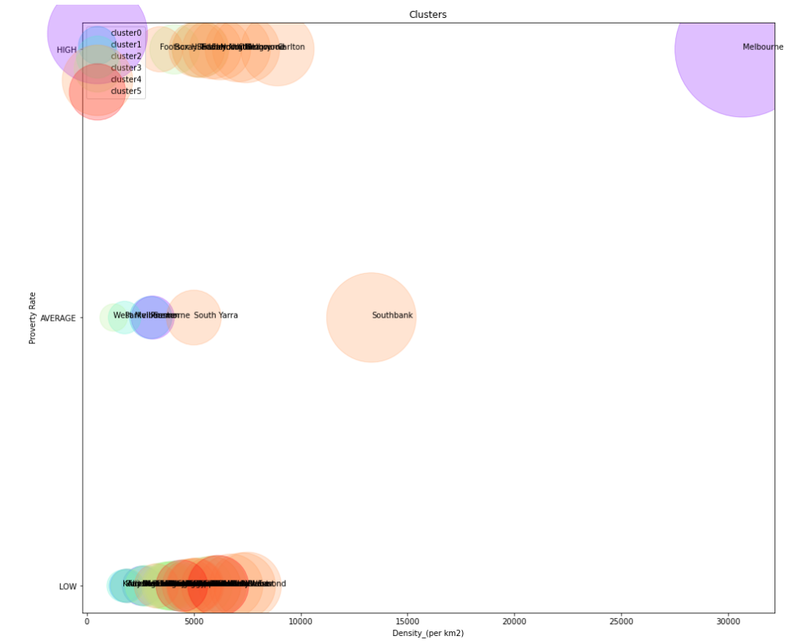
Figure 1: CRIME-RATE VS. DENSITY
Figure 2: PROVERTY-RATE VS. DENSITY
In Figure 1, There is a majority of High Crime Rates regardless of their densities.
The lower the Crime Rate, the less dense it is, that are less targets in these following suburbs
to be guaranteed safe. In Figure 2 a lot of Poverty Rates are low in the 0 and 10000 range, similarly with the
High poverty rates except Melbourne which occurs on the top right. Shows that Urban and populated areas are primary
areas and good attraction to invest in, despite they are main targets that crimes will likely occur depending on any day.

Slide 17
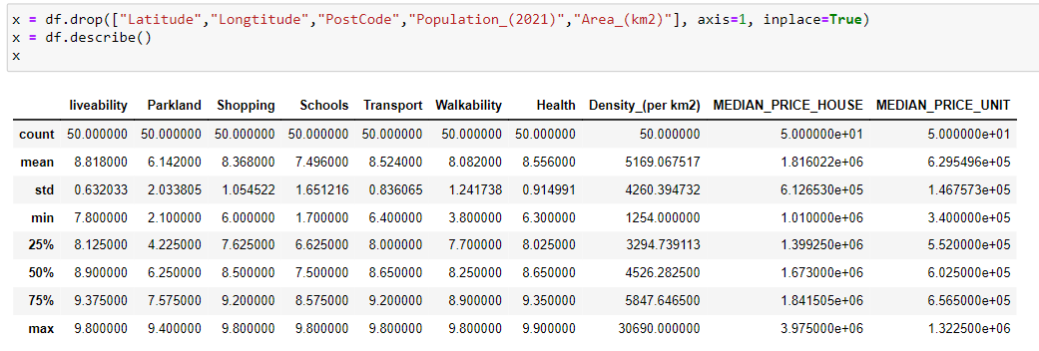
Data Analysis: Data Wrangling
See Data Cleaning before proceeding the following code down below.

Slide 18
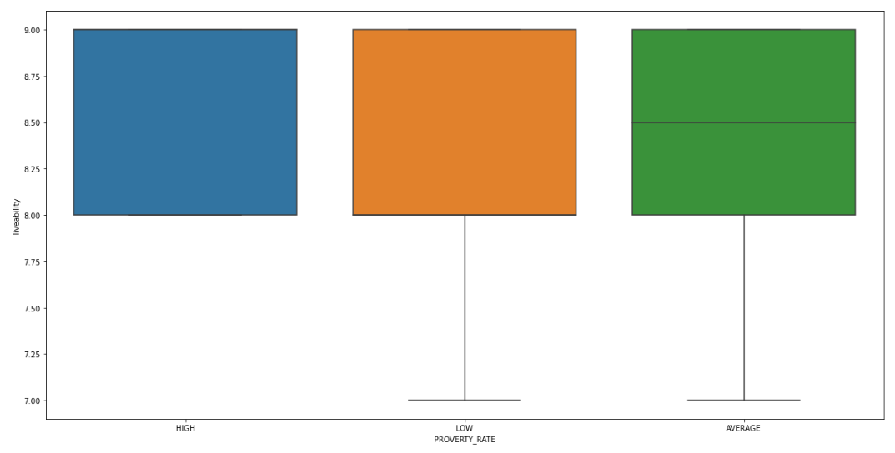
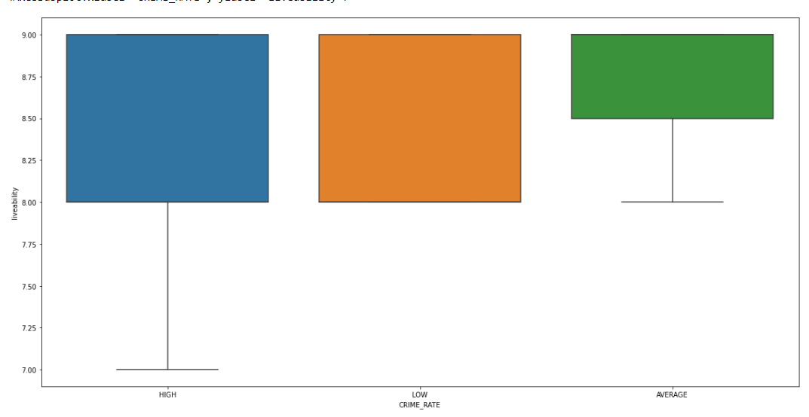
Data Analysis: Exploratory Data Analysis
Figure 1: Poverty Rate vs. Liveability
Figure 2: Crime Rate vs. Liveability
For both these figures, there are no outliners in this case in both ends for each level rate.

Slide 19
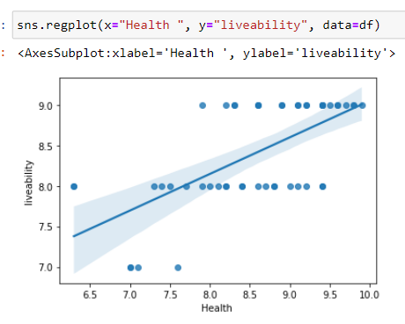
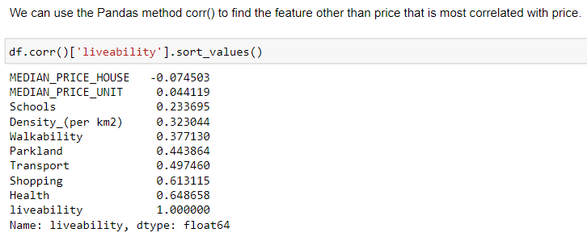
After applying the regplot in the seaborn library with the feature Health
shows a strong positive correlation with liveability in comparison
with the other features.

Slide 20
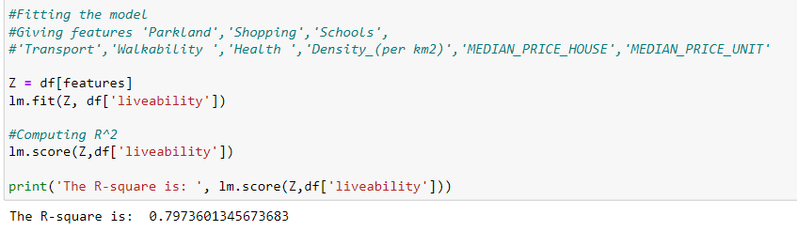
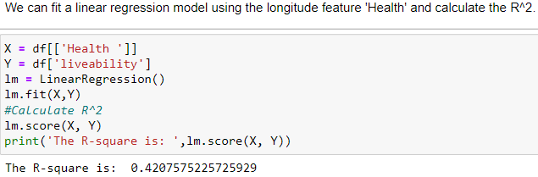
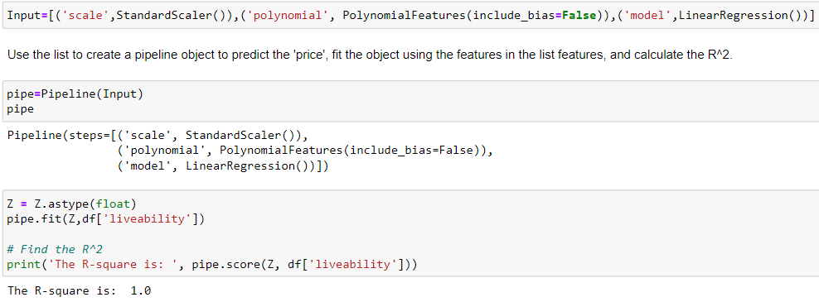
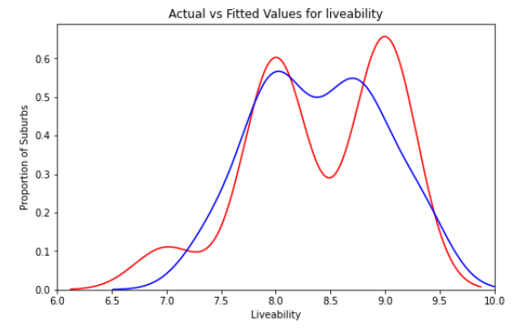
Data Analysis: Model Development
We can see that the fitted values are reasonably close to the actual values since the two distributions overlap a bit.
However, there is some room for improvement.

Slide 21
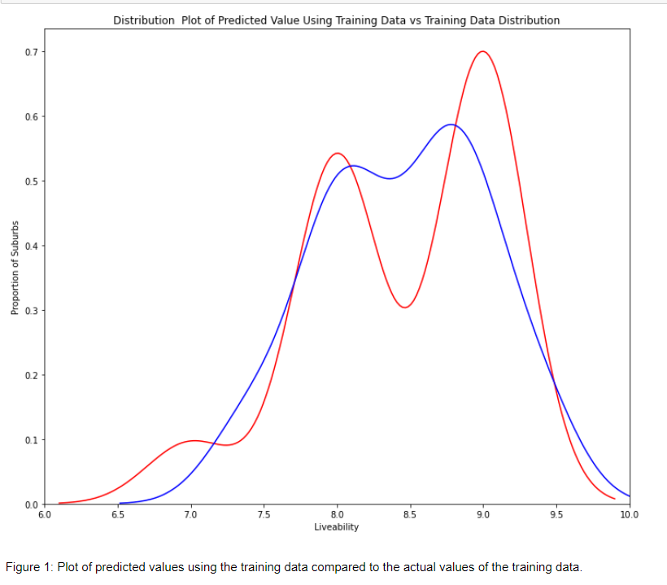
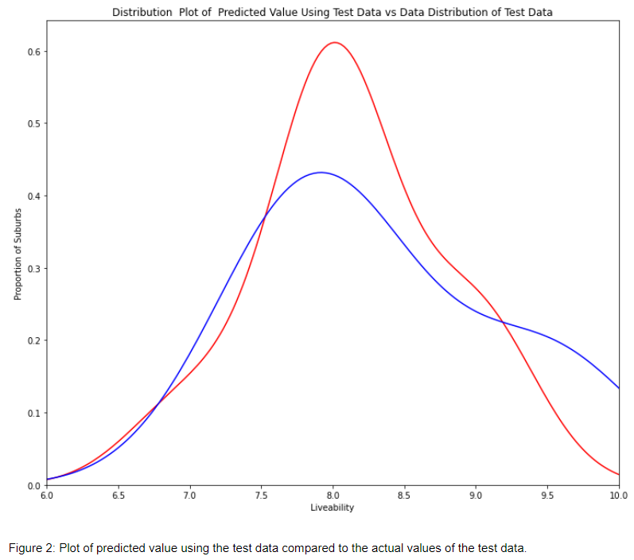
Data Analysis: Model Evaluation and Refinement
features = ['Parkland’, 'Shopping’, 'Schools’, 'Transport’, 'Walkability ','Health ','Density_(per km2)','MEDIAN_PRICE_HOUSE','MEDIAN_PRICE_UNIT']

Slide 22
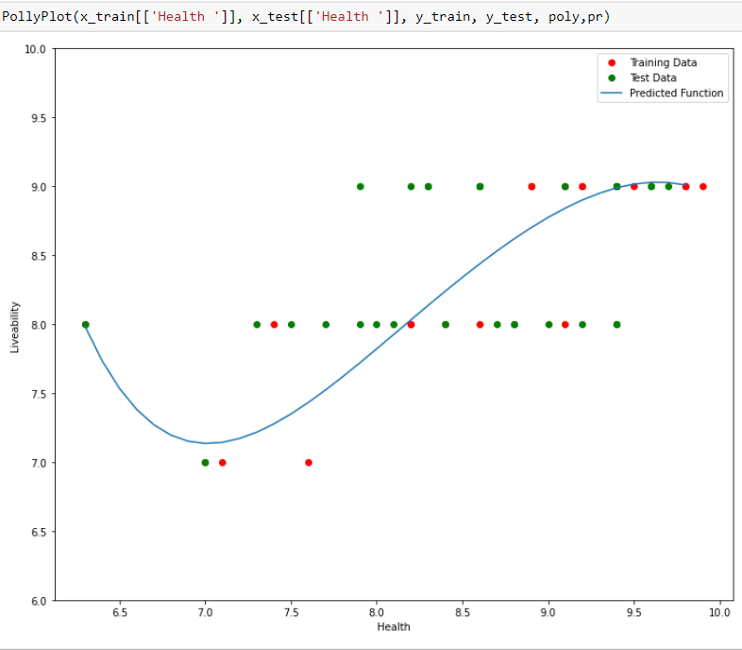
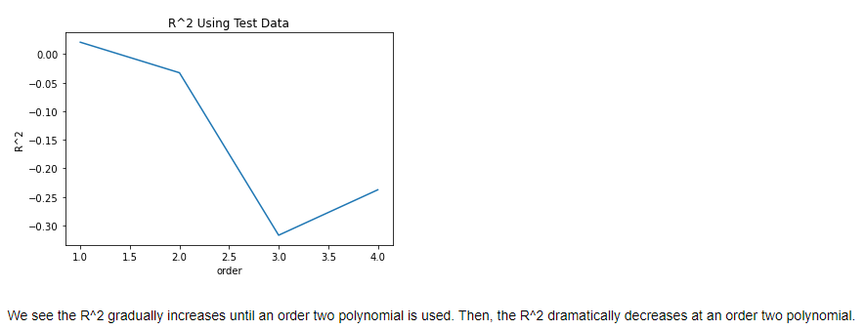
Overall, increasing the order gets worse for the model to fit this may be due to overfitting.

Slide 23
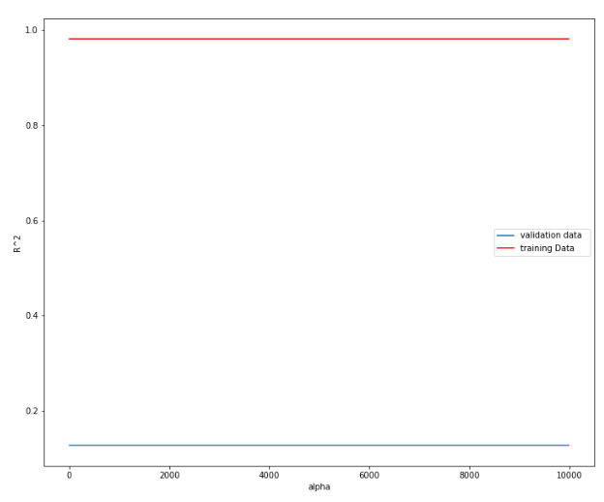
Ridge Regression
Here, we set the alpha level to 0.1. Our aim is to
Minimize the test error for R^2. In this case we see that the training
data stays at 0.981 while the test data is at 0.128. To compare liveability vs. features in the model with degree of 2.

Slide 24
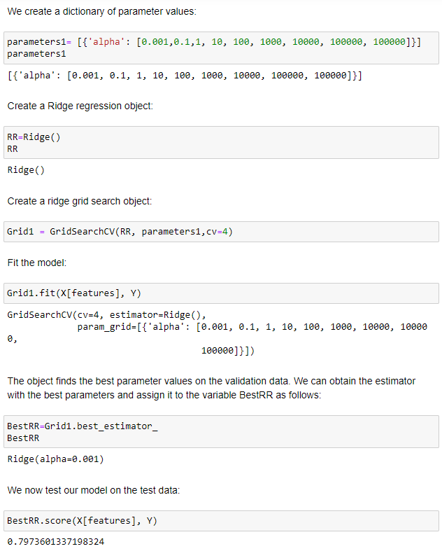
Grid Search

Slide 25
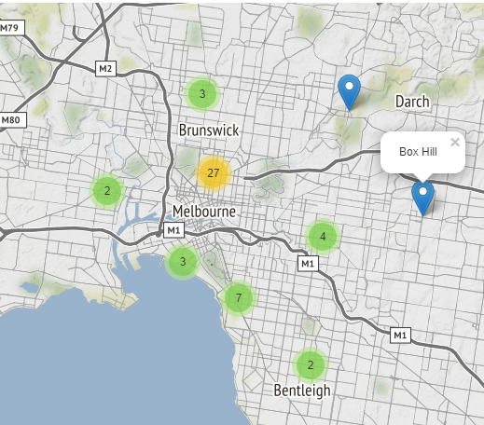
Data Visualisation: Generating the Map
Notice how when you zoom out all the way, all markers are grouped into one cluster, the global cluster, of 50 markers or suburbs, which is the total number of suburbs in our data-frame. Once you start zooming in,
the global cluster will start breaking up into smaller clusters. Zooming in all the way will result in individual markers.

Slide 26
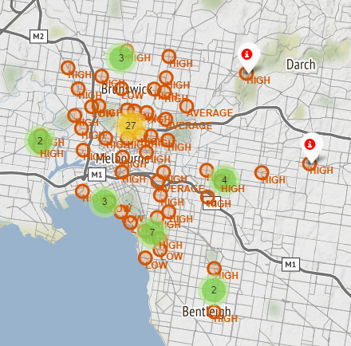
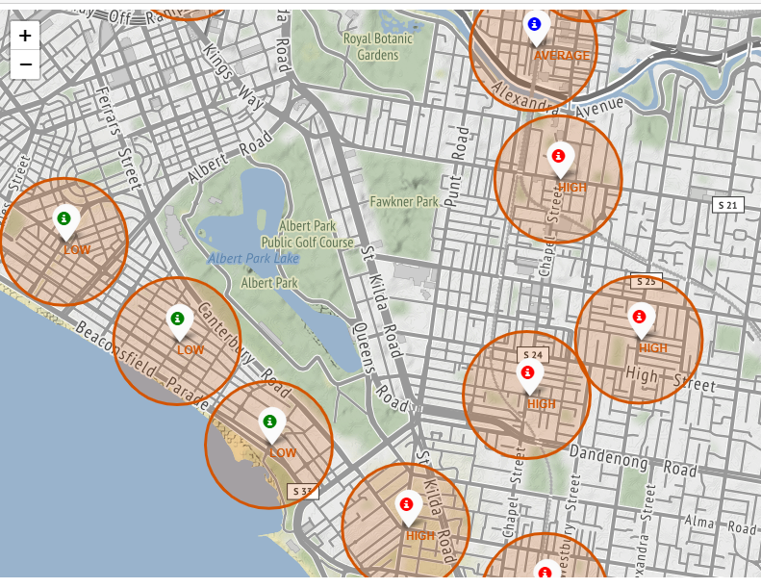
Suburbs with different levels of CRIME RATES
Where HIGH is red, AVERAGE is blue and LOW is green. It is safe to assume that near the costal area of St Kilda and less denier suburbs outside of Melbourne Urban areas are much safer overall.

Slide 27
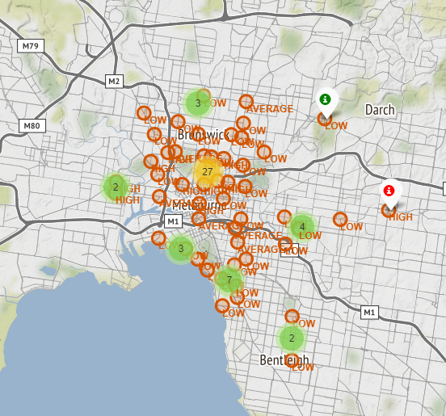
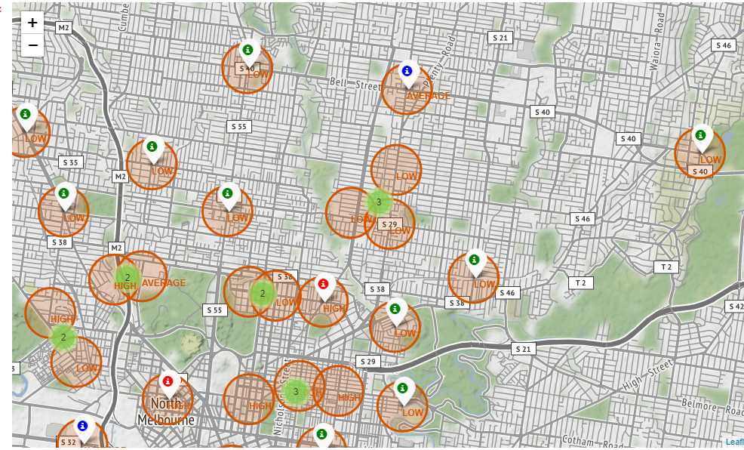
Suburbs with different levels of POVERTY RATES
For poverty rates we notice there are low and average rates are effected in these suburbs close or away from the City of Melbourne. Due to the overall economic growth and access in modern technology, infrastructure, healthcare.

Slide 28
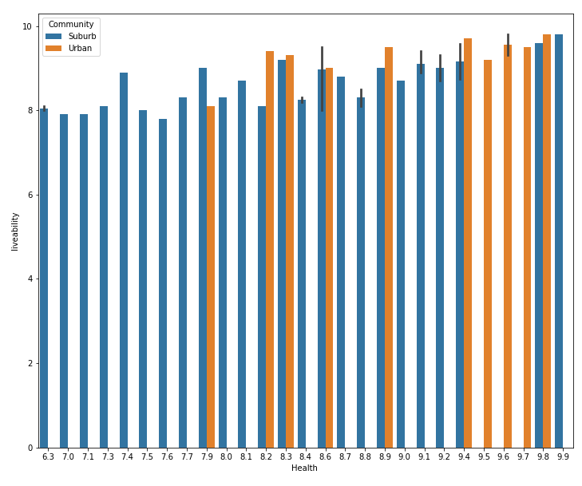
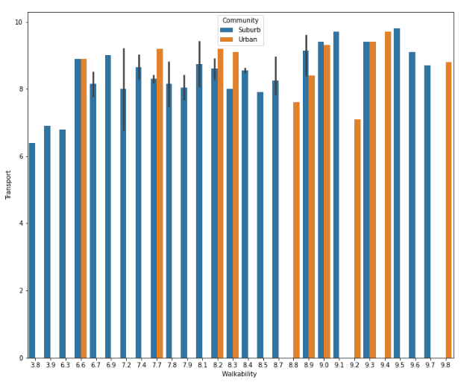
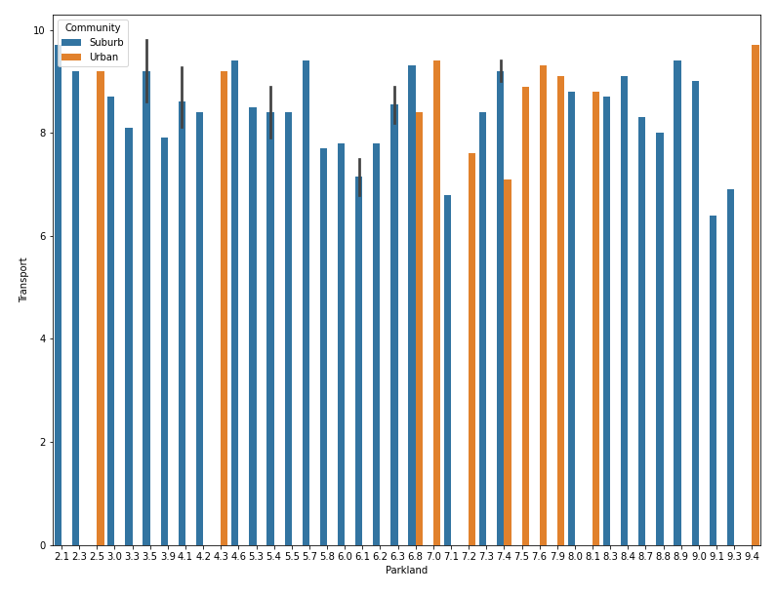
Data Visualisation: Plotly Charts
Box-Plots
There is a linear relationship between Healthcare centres
and Life Liveability. Where Urban areas have a lot more
Compare to Suburban areas.
There is no relationship or correlation between Transportation and Parking. Since transportation and parking is hard to access in rural areas compared to Urban areas becomes an issue due to added remote parking spaces and increase requirements on roads to avoid traffic congestion.
There is no relationship or correlation between Walkability vs. Transportation. Since different kind of transportation such as trains, buses, taxis compared to able to commute by foot. Since it should not be an issue in Urban areas and Suburban areas that not in Melbourne help avoid costs in transportation.

Slide 29



Transportation seems very decent
since we depend on Life liveability. To save time and improve health, cultural development and the environment. Since Urban areas are improved better compared to some Suburban Areas.
Refer from Parkland vs. Transport
Walkability in some Suburban areas are
scored low due to the neighbourhood they
are currently living in. Whereas in Urban Areas
scored at least 6.6 to 10 seems to be decent depending
on any day given.

Slide 30


In Urban Areas Schools near the City of Melbourne implies better quality
Schools in Victoria. Compared to the Suburbs that are heavily replied on
due to poverty, knowledge, classroom size and outdated technology due to
budget constraints (See Unsupervised Learning: K-Means Clustering)
.To ensure students and residents guarantee and secure career
opportunities.
It appears that quality of shopping is significantly better in Urban Areas
compared to Suburban Areas. Depending on customer decision whether
they should buy online to avoid queues may risk on scams and refunds that
can not be guaranteed, time constraints or in person to reduce delivery costs.

Slide 31






Histograms

Slide 32







Slide 33
Summary of the Histograms
In liveability some bins frequently occur between 8 to 9.5 which is fairly distributed.
Density is calculated by the Population over the Area roughly occurs between the 1500 and 5000 despite there is 1 count with at least 30000 coming from the City of Melbourne
. Median House Prices bins frequently occur around 1 to 2 million dollars, whilst at least 2 million dollars. Parking is fairly distributed from 2 to 9 may be due the number of spaces depending on the suburb they are currently living in. Shopping has some bins frequently occur 8 to 10 with the minimum score is 6 which is very decent. Schools range 5 to 10 depending on the suburb and area they are living in notice some bins at 0-2 and 3-4 which is deeply concerning. Transport occurs on 7.5 and 9.5 some lie from 6-7.5 similar reason to the parking case.
Walkability ranges from 6-10 whilst there is 1 bin at 3-4 does not occur well may imply a rural suburb. Health occurs around 7-10 which seems decent, there is 1 bin occur at
Median Unit Prices frequently occur at prices at 500000 and 700000 dollars.

Slide 34
Conclusion

Slide 35
The best suburbs to live in based on the methodology and applying possible
analysis, visualization, statistics and machine learning techniques. Some suggestions of the following
suburbs are Ripponlea, Cremorne, Albert Park, Princes Hill, Carlton North, Brunswick, Clifton Hill, Elwood, Middle
Park, Fairfield and St. Kilda West. If we gather more information for all suburbs in Victoria, Australia we would have provided accurate results that is required to fulfil this project.

Slide 36

Appendix
19 Reasons Why Melbourne is the Best City on the Planet | Sitchu Melbourne
Melbourne’s top 50 most liveable suburbs revealed - realestate.com.au
Australian Median House Prices, Property Market Data & Suburb Profiles – realestate.com.au

